Slide 1

DDOS ATTACK DETECTION AND MITIGATION IN SDN: ML ASSISTED APPROACH
Course Instructor: Dr. Sudipta Saha

Slide 2
Contents:
What is sdn?
Ddos attacks and its types
Simulating a network using mininet and RYU controller
Simulating ddos attack
Proposed detection algorithm
Detection Procedure
Mitigation algorithm
Dataset features
RESULTS
REferences

Slide 3
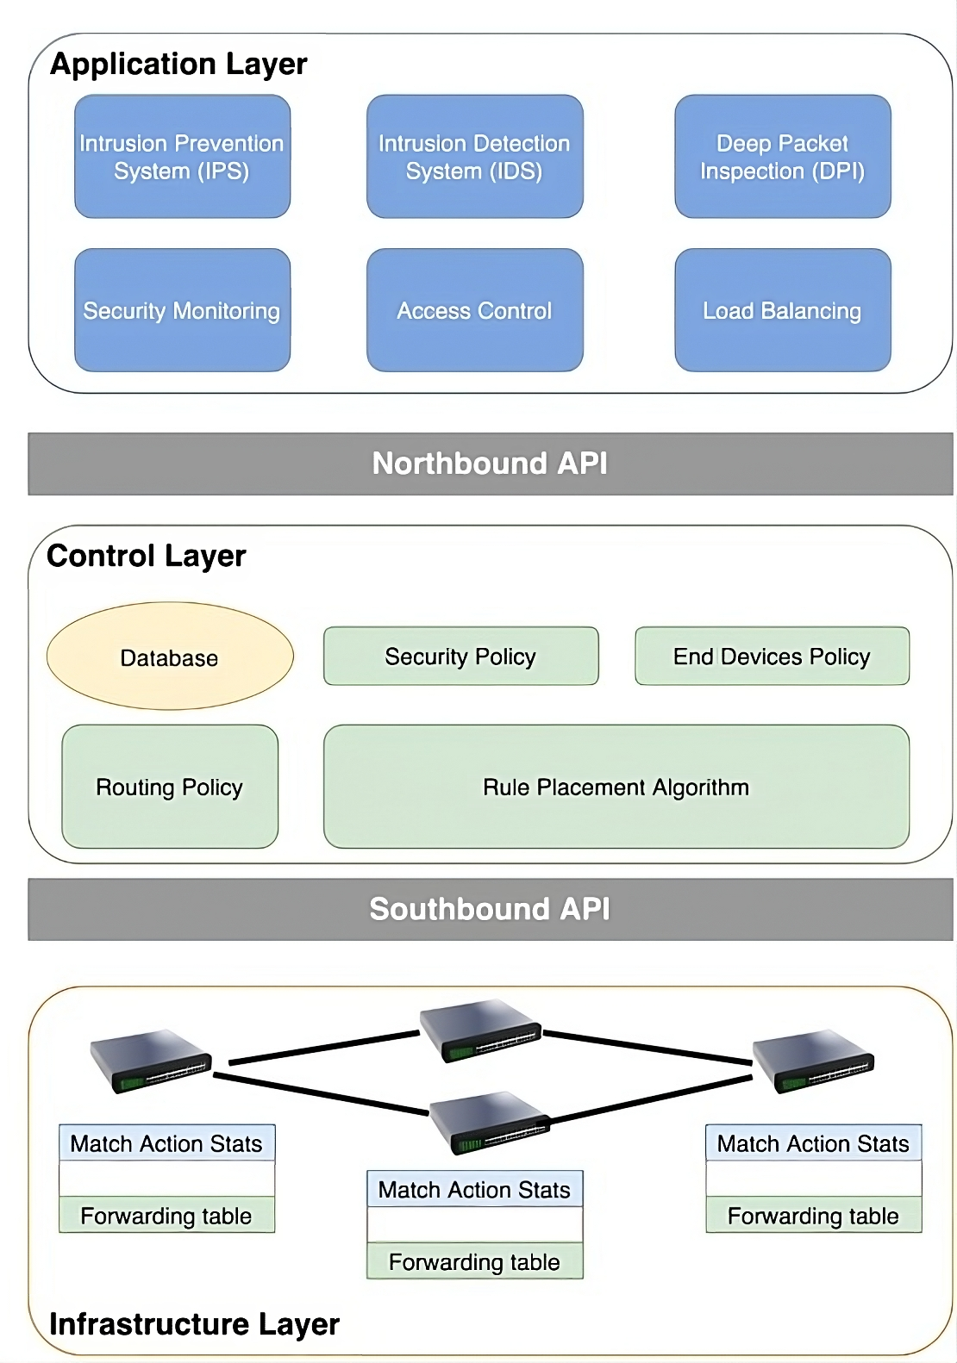
What is sdn?
Centralized Control: Decouples control from hardware for programmable networks.
Streamlined Management: Simplifies network configuration and oversight.
Open Protocols: Promotes compatibility and vendor independence.
Network Agility: Facilitates dynamic resource allocation.
Security: Improves network monitoring and policy enforcement.

Slide 4
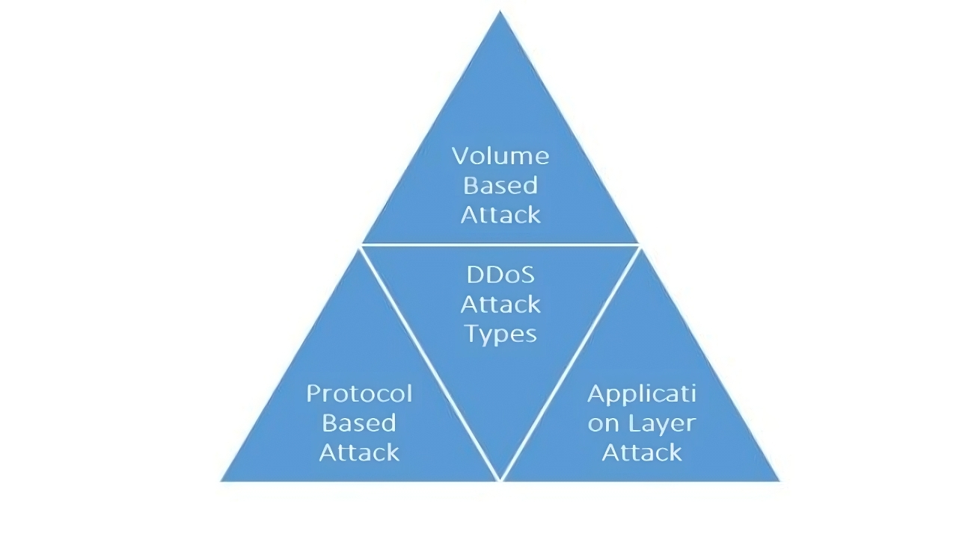
Ddos attacks and its types:
A Distributed Denial-of-Service (DDoS) attack is a cybercrime in which the attacker floods a server with internet traffic to prevent users from accessing connected online services and sites. Here are the types of DDoS attacks:
Volumetric: Floods with traffic to saturate bandwidth.
Protocol: Targets infrastructure to drain system resources.
Application Layer: Exploits web apps to exhaust server functions.

Slide 5
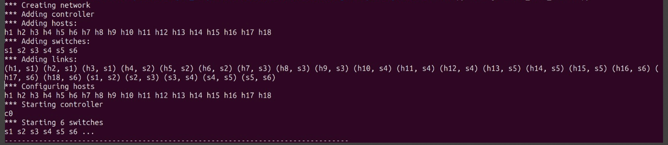
Simulating a network using mininet and RYU controller:

Slide 6
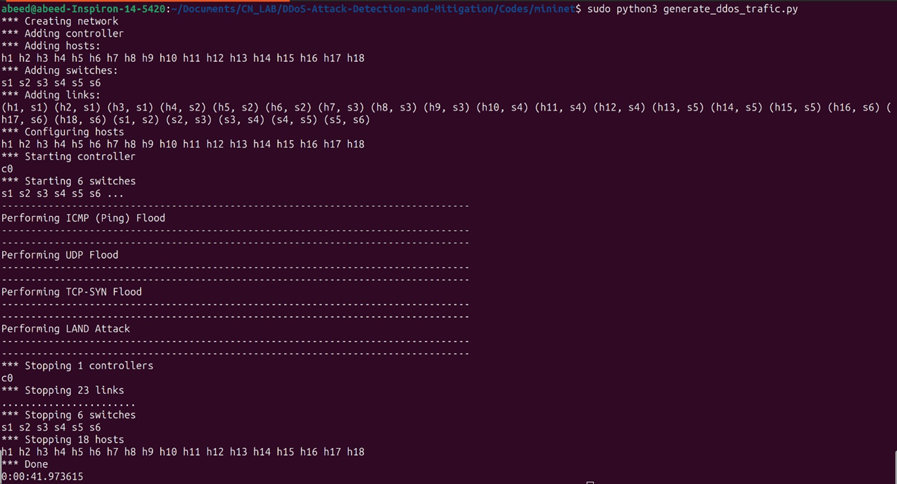
Simulating ddos attack:

Slide 7
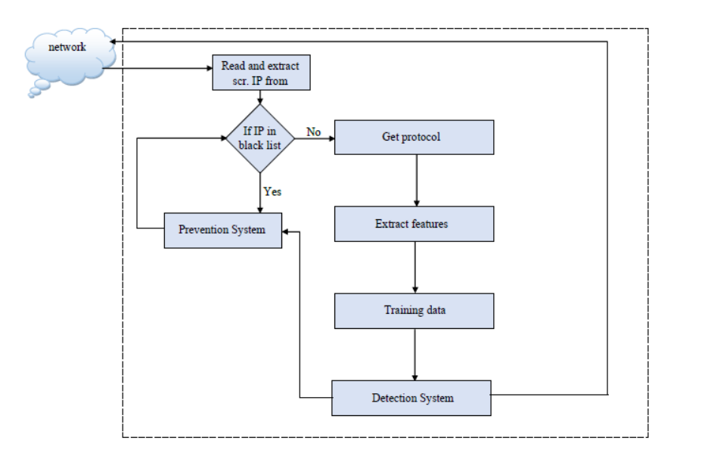
Proposed detection algorithm:
Capture Source IP: Extract the source IP address from network traffic.
Check Blacklist:
If IP not in blacklist, proceed to identify the communication protocol.
If IP is blacklisted, take preventive actions (e.g., block it).
Feature Extraction: Extract relevant features (e.g., packet size, ports) from network data.
ML Model: Use extracted features to train a machine learning model.
2.Detection System: Analyze incoming traffic using the trained model.
3.Classification: Classify traffic as normal or malicious.

Slide 8
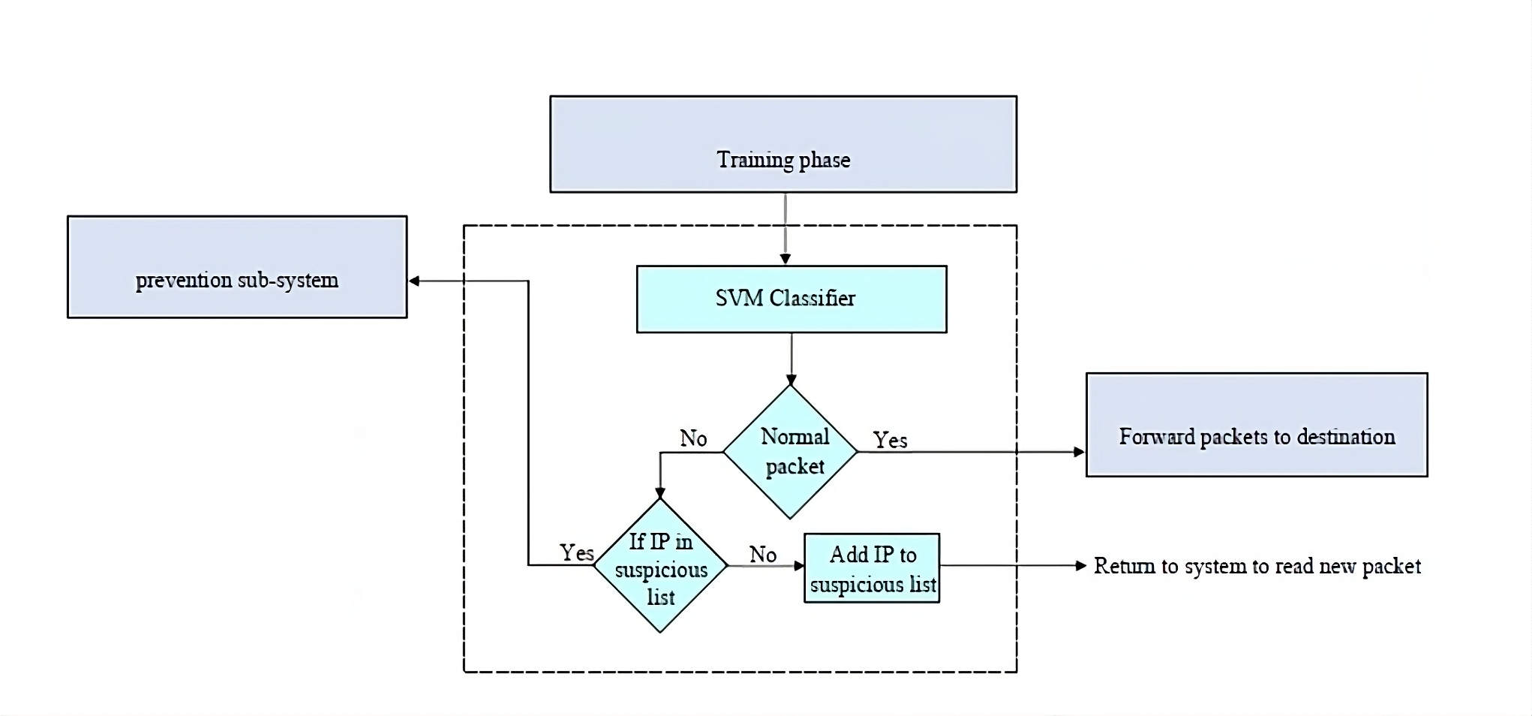
Detection Procedure:
Start: The process starts with an incoming packet.
SVM Classifier: The SVM classifier is a machine learning algorithm that has been trained on a dataset of suspicious and normal packets. The algorithm classifies the incoming packet as normal or suspicious packet.
Normal: If the SVM classifier classifies the packet as normal, the process ends.
Suspicious: If the SVM classifier classifies the email as suspicious:
If the IP is already in IP suspicious list, go to prevention subsystem.
If the is not in suspicious list, add it to suspicious list and return.

Slide 9
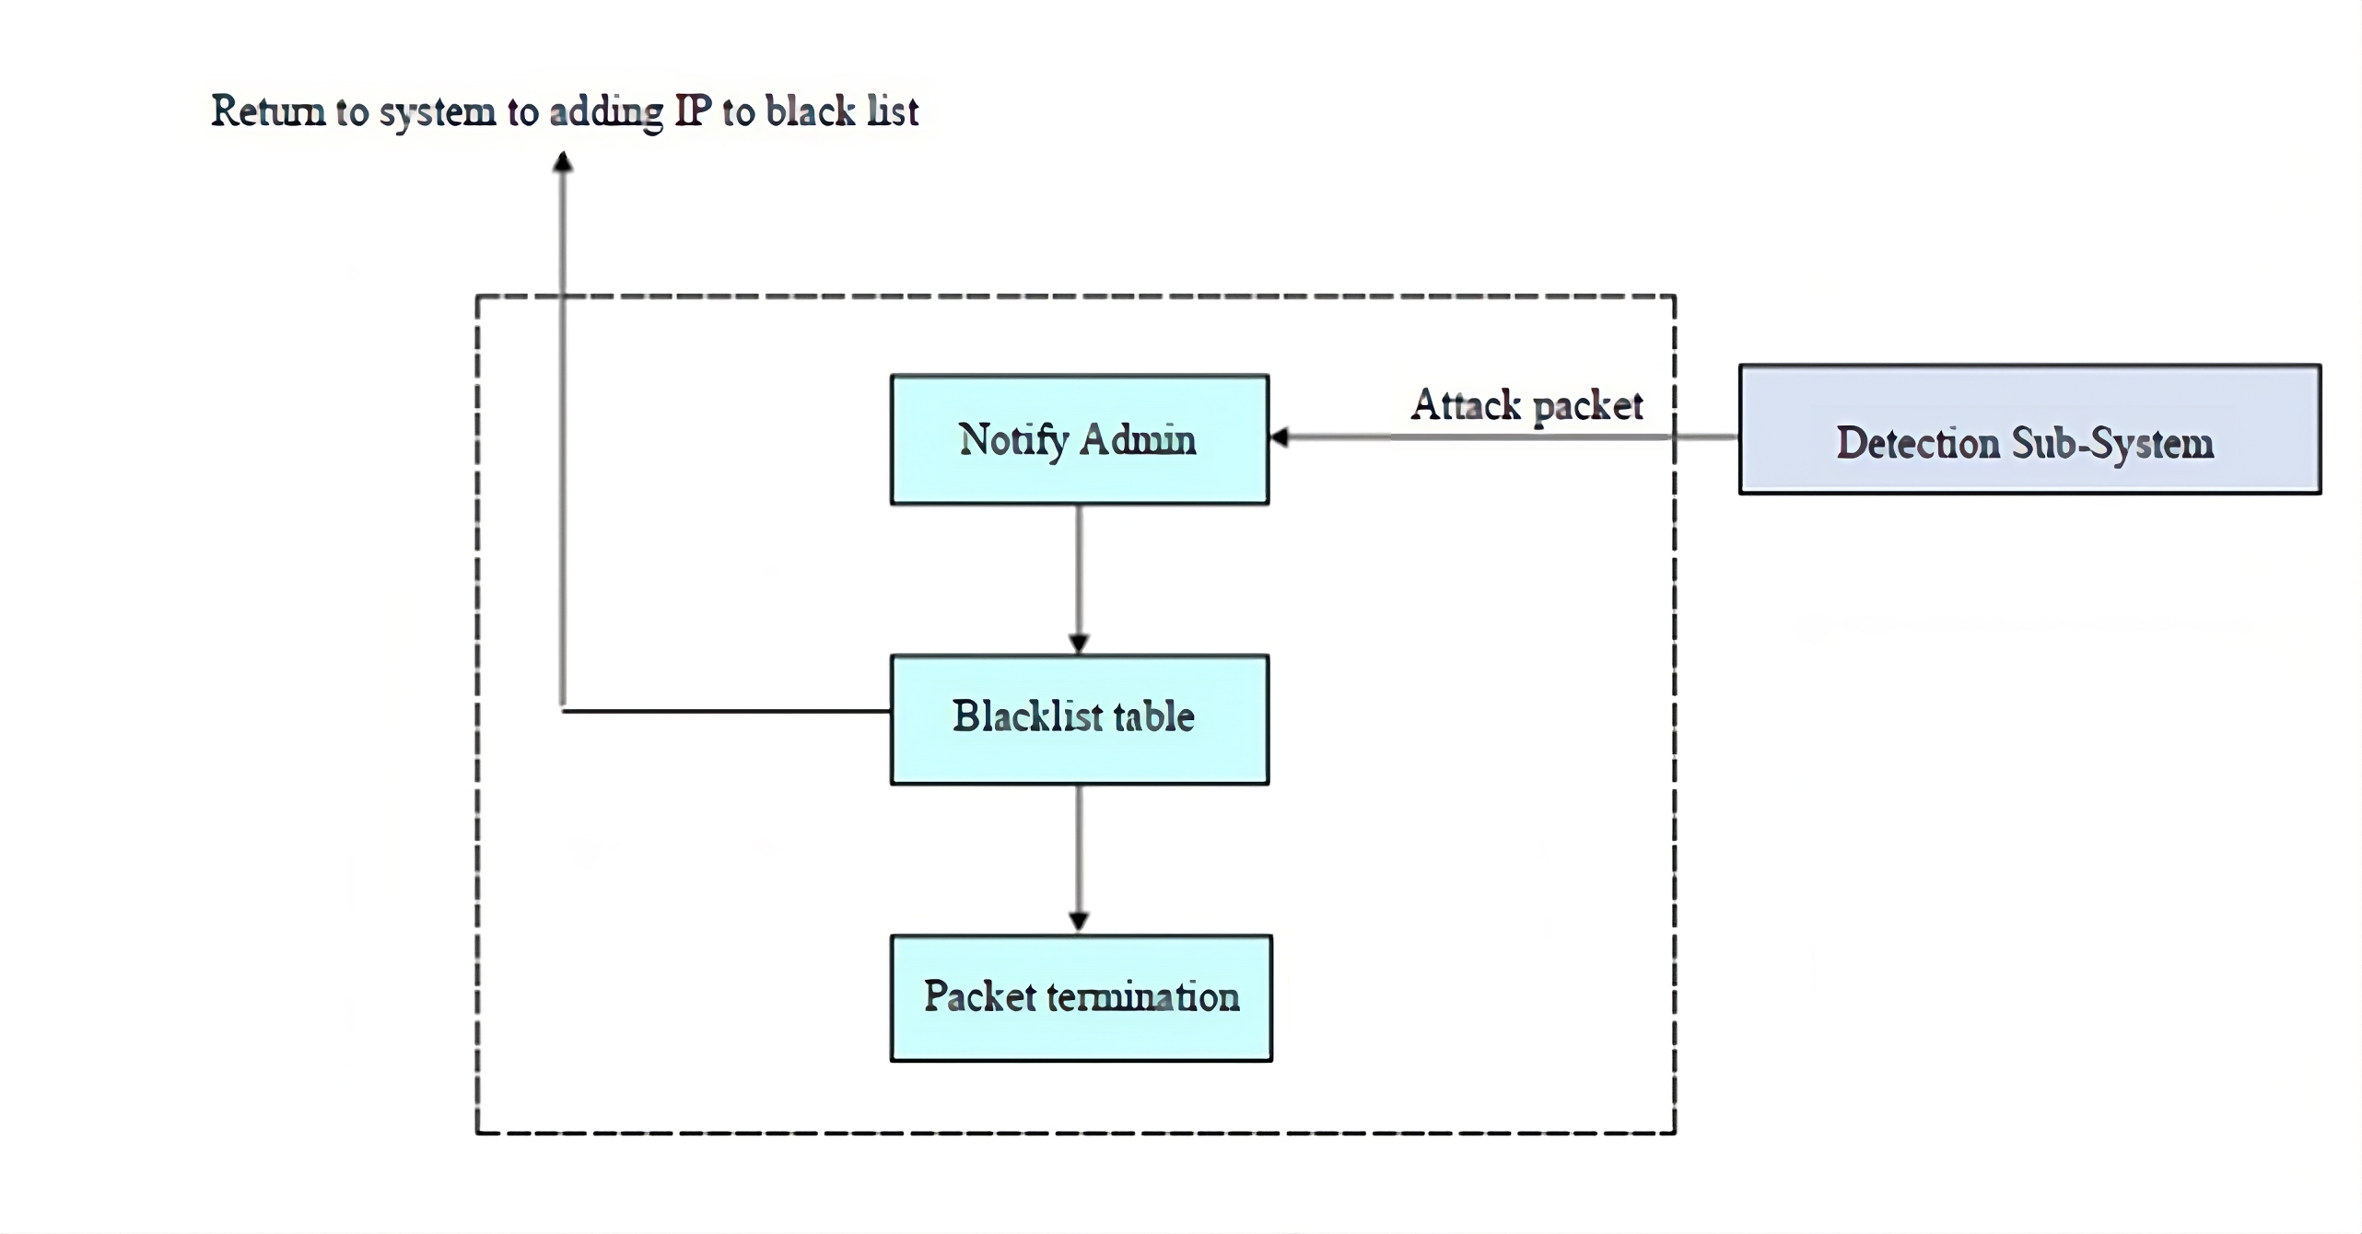
Mitigation algorithm:
Detection Sub-System: This is the starting point where the system continuously monitors network traffic to detect potential DDoS attacks using machine learning algorithms.
Attack Packet: Once a potential attack is detected, the system identifies the specific packets that are part of the DDoS attack.
Notify Admin: The system then alerts the network administrator about the detected attack, allowing for human oversight and intervention if necessary.
Blacklist Table: The attacking IP addresses are added to a blacklist table. This step is crucial to prevent further packets from these IPs entering the network.
Packet Termination: Finally, packets originating from the blacklisted IP addresses are terminated, stopping the DDoS attack from affecting the network’s operations.
Return to System: After dealing with the attack, the system returns to monitoring the network, adding any new attacking IPs to the blacklist as needed.

Slide 10
Dataset features:
Feature | Description
dt | Timestamp of the event
switch | Switch ID
src | Source IP address
dst | Destination IP address
pktcount | Count of packets in the flow
bytecount | Count of bytes in the flow
dur | Duration of the flow in seconds
dur_nsec | Duration of the flow in nanoseconds
tot_dur | Total duration of the flow
flows | Number of flows
packetins | Count of packet insertions
pktperflow | Packets per flow
byteperflow | Bytes per flow
Feature | Description
pktrate | Packet rate per second
Pairflow | Pair flow
Protocol | Protocol used in the flow (e.g., TCP, UDP)
port_no | Port number
tx_bytes | Transmitted bytes
rx_bytes | Received bytes
tx_kbps | Transmitted kilobits per second
rx_kbps | Received kilobits per second
tot_kbps | Total kilobits per second
label | Label indicating the classification or outcome of the flow

Slide 11
RESULTS:
In binary classification problems, four parameters are used to represent the confusion matrix, which are the number of true positives (TP), true negatives (TN), false positives (FP) and false negatives (FN). A brief explanation of these parameters is discussed below.
TP: indicates the number of anomaly flows that are correctly classified as anomaly.
FN: indicates the number of anomaly flows that are incorrectly classified as normal.
FP: indicates the number of normal flows that are incorrectly classified as anomaly.
TN: indicates the number of normal flows that are correctly classified as normal.
For our anomaly detection problem, accuracy (ACC),
precision (P), recall (R), specificity (S), training time, and
testing time were used as evaluation metrics. The
discussions of these metrics along with their formulas are
given below:

Slide 12
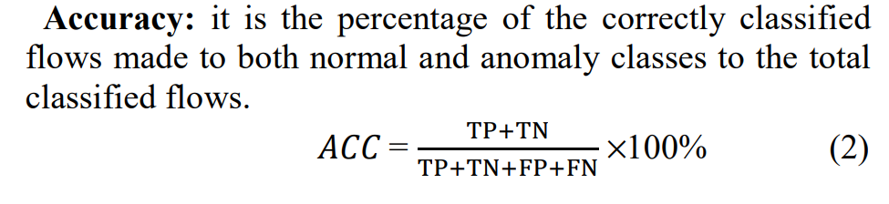
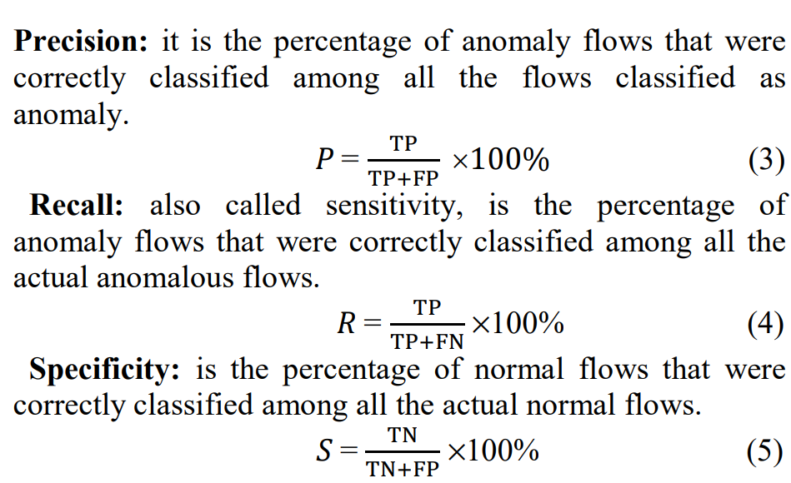
RESULTS:

Slide 13
RESULTS:
Using All Features
Algorithm | Accuracy | Precision | Recall | F1-Score
Logistic Regression | 76.4% | 0.73 | 0.80 | 0.78
Support Vector Machines (SVM) | 97.0% | 0.97 | 0.98 | 0.97
Random Forest | 99.99% | 1.00 | 1.00 | 1.00
K-Nearest Neighbors | 98% | 0.99 | 0.99 | 0.99

Slide 14
RESULTS:
Using Feature Selection:
Feature | Weight
src | 17.87
pktcount | 15.16
dst | 13.64
byteperflow | 12.97
pktperflow | 11.35
pktrate | 11.35
tot_kbps | 9.68
rx_kbps | 9.66
flows | 8.95
bytecount | 4.92
dt | 2.33
Protocol | 1.31
dur | 1.11
tot_dur | 1.11

Slide 15
RESULTS:
Performance with Selected Features:
Algorithm | Accuracy | Precision | Recall | F1-Score
Logistic Regression | 75.21% | 0.85 | 0.77 | 0.81
Support Vector Machine (SVM) | 91.77% | 0.90 | 0.93 | 0.94
Random Forest | 99.42% | 0.99 | 1.00 | 1.00
Decision Tree | 94.19% | 0.91 | 1.00 | 0.95

Slide 16
REferences:
https://iopscience.iop.org/article/10.1088/1757-899X/466/1/012003/meta
https://iopscience.iop.org/article/10.1088/1755-1315/252/3/032013/met
https://www.sciencedirect.com/science/article/abs/pii/S0140366415002285
https://ieeexplore.ieee.org/abstract/document/9492558/

Slide 17

THANK YOU
GROUP 18:
Arihant (21CS01033) Abeed (21CS01072) Priyam (21CS01076)

